Slide 1
SAGAR KALAUNI
2024 Analytics & Insight-Intern

Slide 2
Repairable Item Analysis
Goal: To track the items that are marked repairable in Maximo to know their present condition.
Tracking items based on workorder they issued or returned.
What my dashboard should look like?
Main Heading
Item slicer
Item no. | Total Issue qty | Total Return qty | Present condition | Remark | History | Item Description
123421 | -5 | 3 | -2 | check | XXXX | Chain Xxxxx xxxxxx
. . . . | . . . . | . . . . | . . . . | . . . . | . . . . | . . . .
Workorder | Total issue qty | Total return qty | Remark
9876543 | -1 | 2 | …
… | … | … | …
Drill through for workorder
Details on workorder

Slide 3
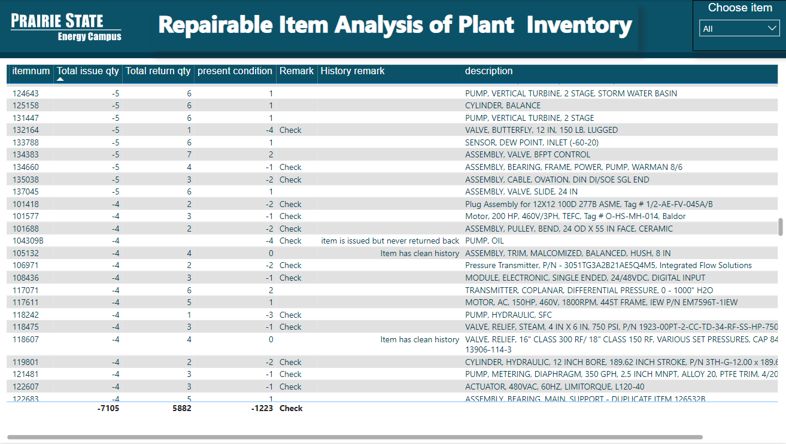
Repairable Item Analysis
Drill Through

Slide 4

Special Thanks To:
Josh Hagene, Mackenzie Tabing, Jonathan Sander, Jeff Miller, Tom Foust Jr
Tyler Tiemann, Claire Beyes, Alyssa Lohmann
David Sohn, Dustin Wethen, Justin Gale
Randy Short and whole PSGC teams.

Slide 5


